Slide 1
ReSToRe
Workshop 23/08/21

Slide 2

Genomics Coordination Center
Hosted by the University Medical Center Groningen (UMCG)
Dept. of Genetics
+ 30 researchers, bioinformatics analysts, software developers & data managers

Slide 3






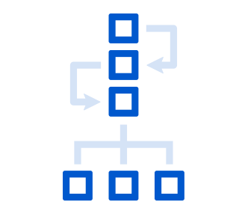

Our products
Catalogue
Find and request access to
collections, data items and samples
Flexible data platform
Your own data models, script and apps
for all your data and analyses
RD3
Metadata about datasets, samples,
patients, mutations, files and analyses
GDIO
Omics annotation and classification
toward genome diagnostic interpretation
Federated access/analysis
Multi-center distribute analysis
without disclosing sensitive data
FAIR*connect
Automatically map your data to
interoperable models and ontologies
Omics pipelines
Large scale DNA, RNA, methylation,
Micriombe data processing
Analysis cloud
Secure & reproducible analysis,
benchmarks and reference data
We thank Noun project for use of the icons.

Slide 4
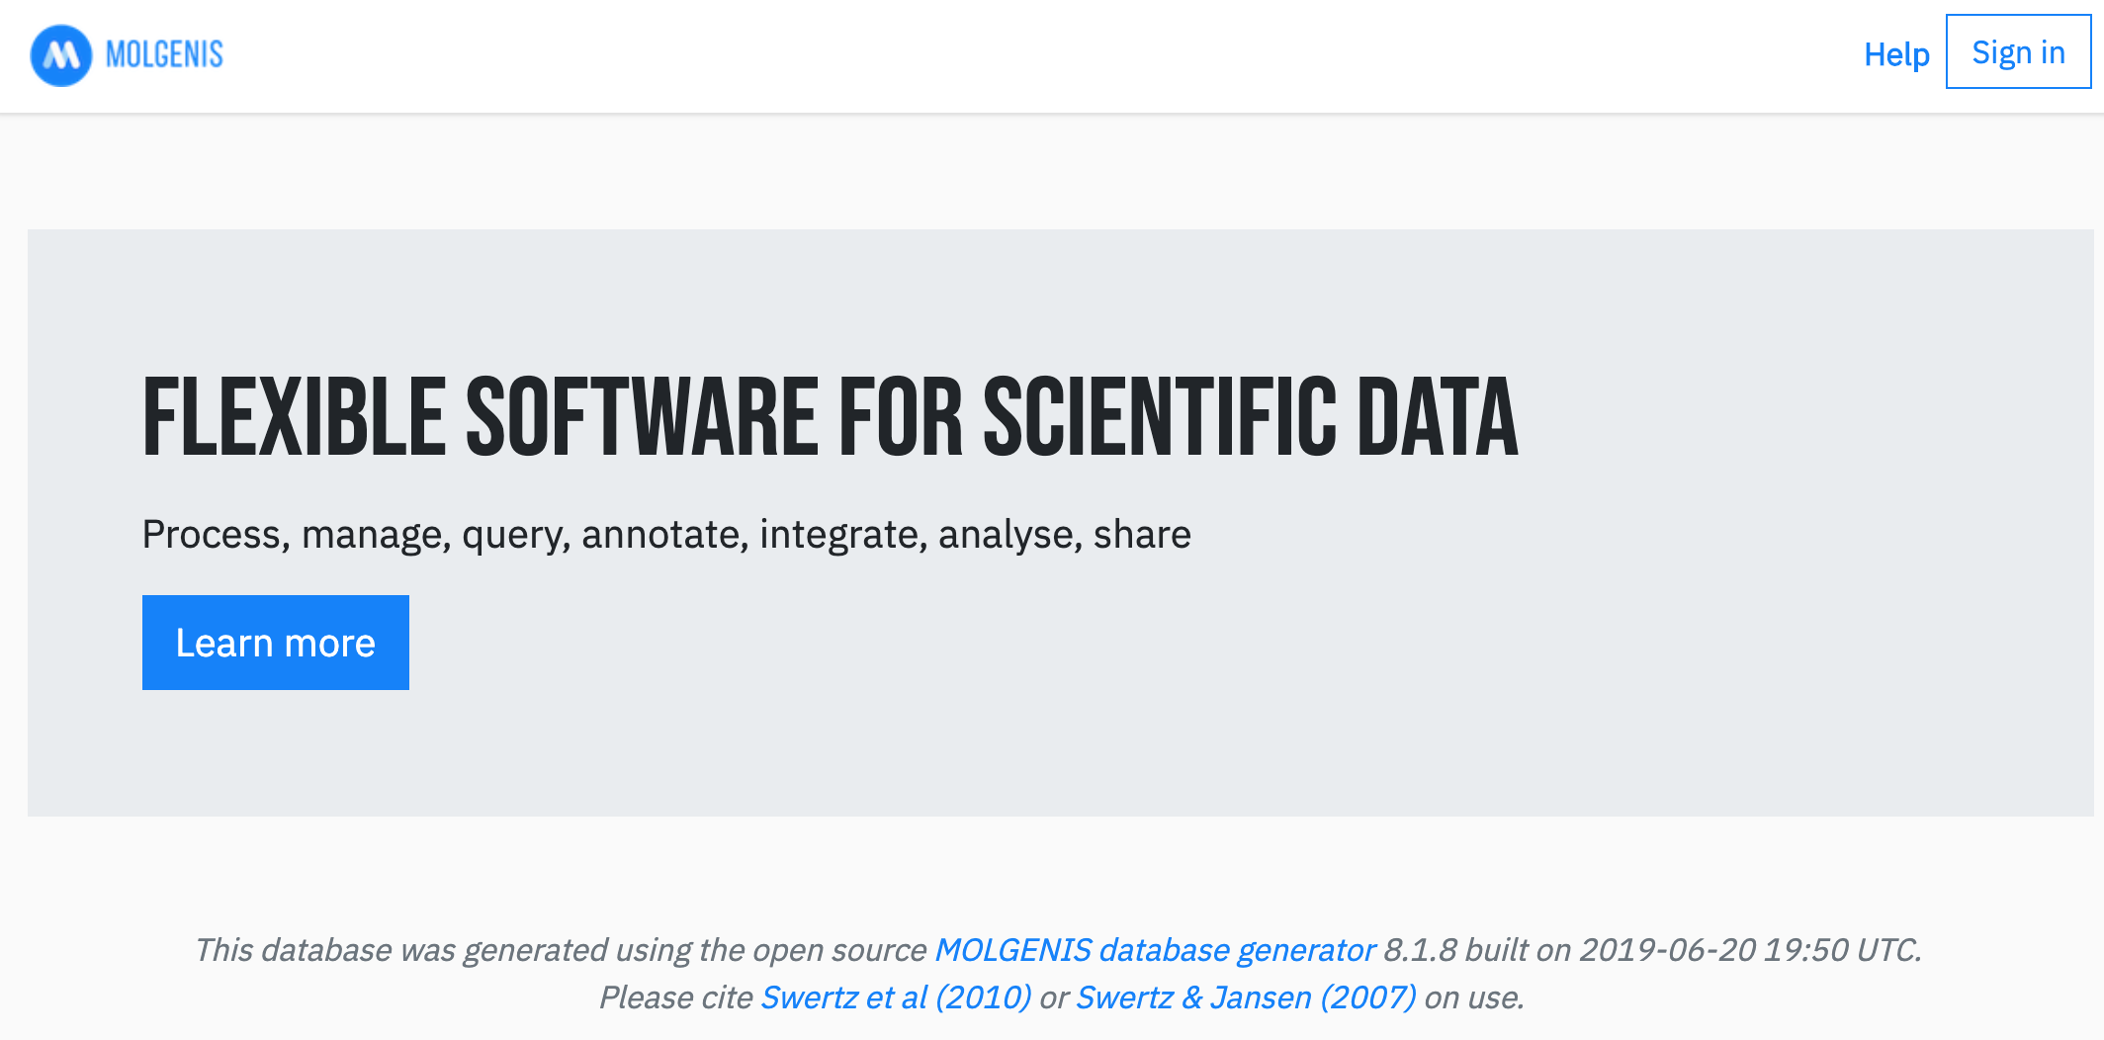
Open source MOLGENIS suite http://molgenis.org http://github.com/molgenis
https://www.youtube.com/watch?v=n28iGckSOz0

Slide 5
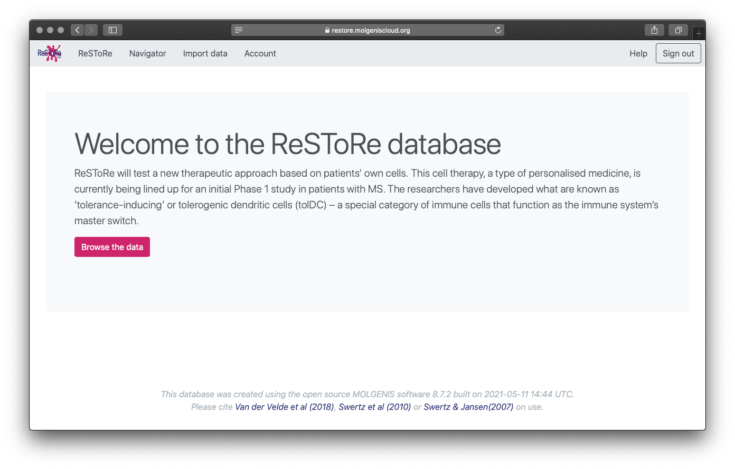
Let’s start!
https://restore.molgeniscloud.org
Notes:
After you login you have a few options in the menu. We’ll start with import data.

Slide 6
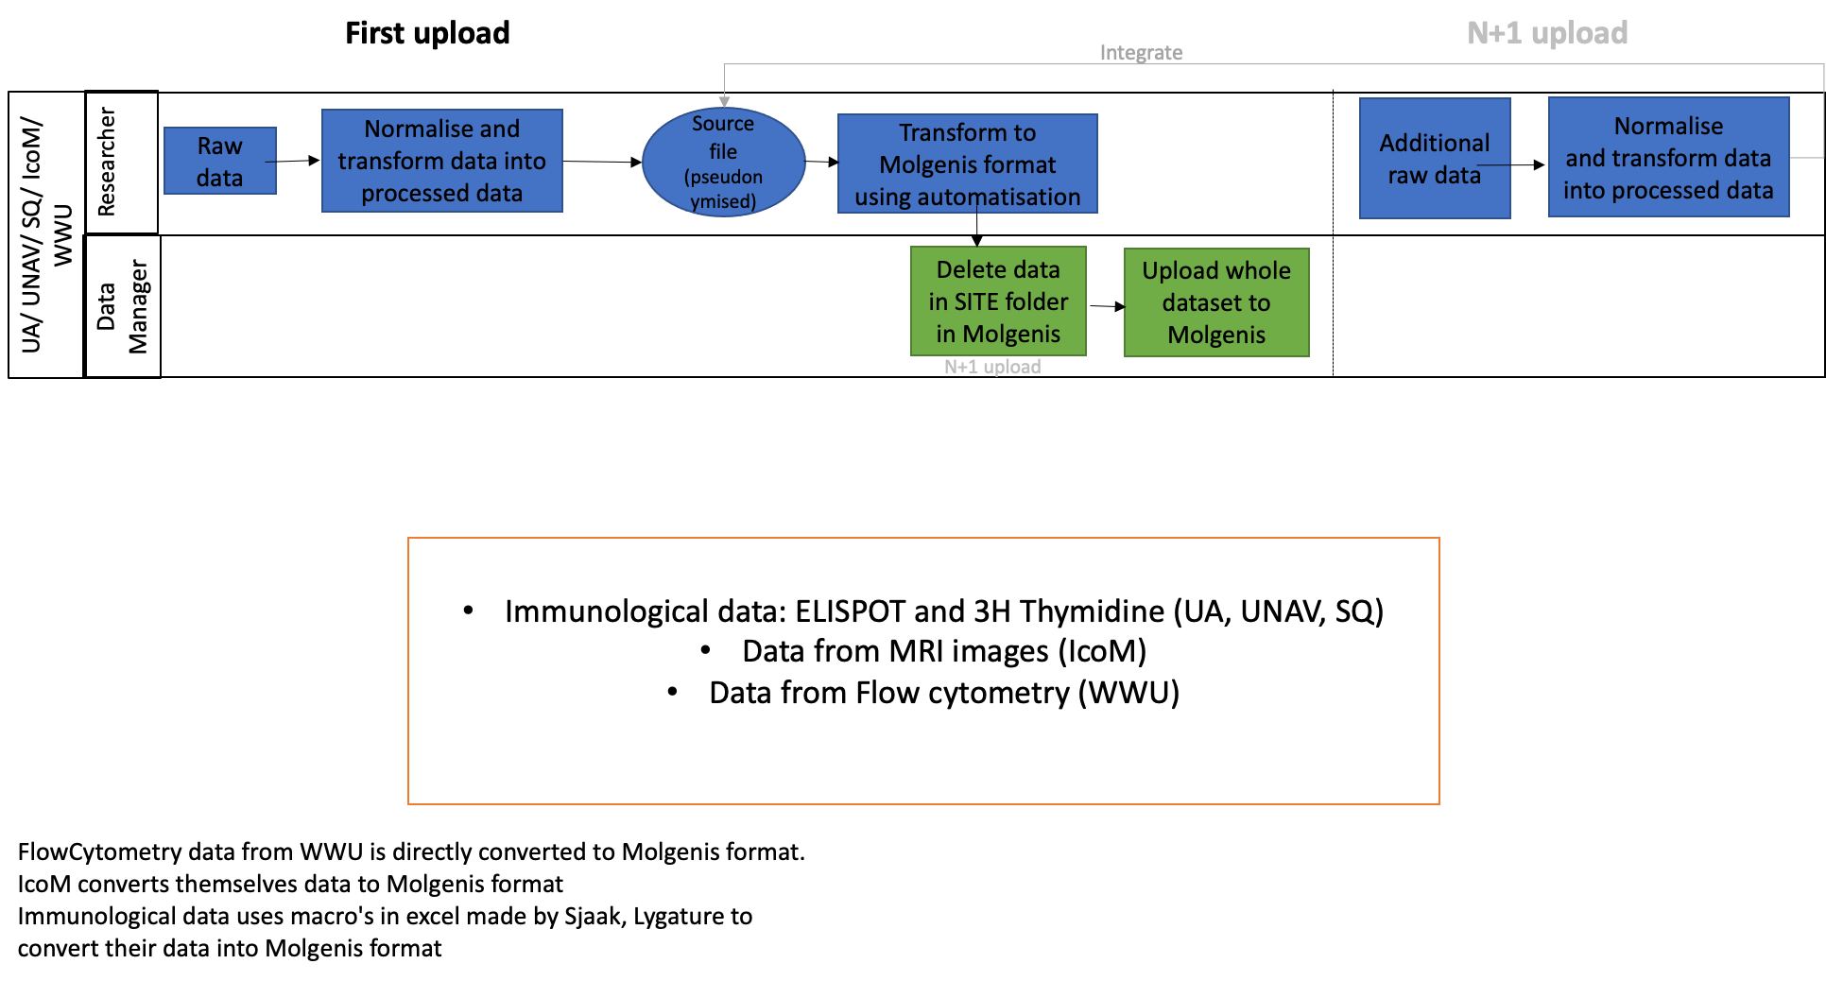
Prepare your files
Notes:
Excel sheet name should correspond to table you want to upload

Slide 7
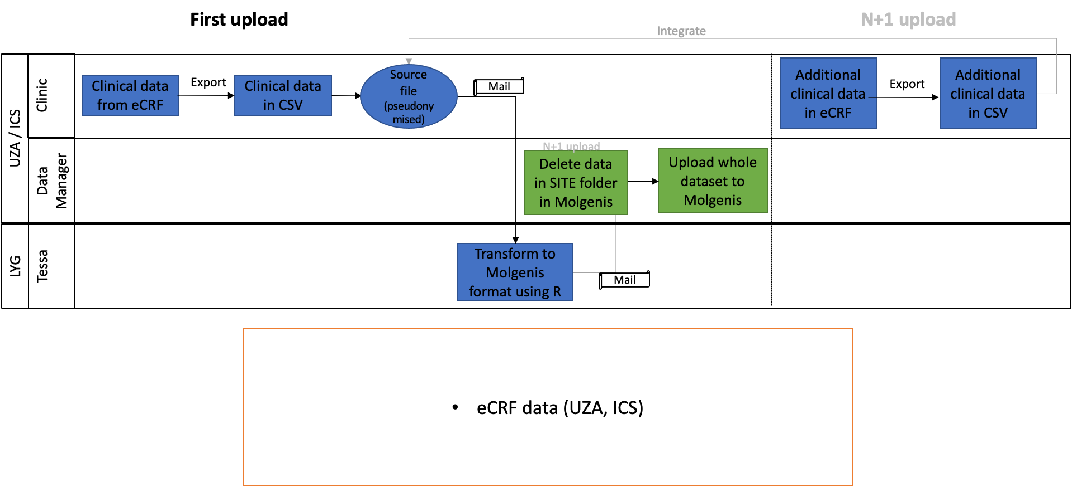
Prepare your files
Notes:
Excel sheet name should correspond to table you want to upload

Slide 8
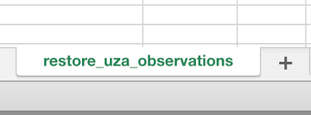
Prepare your files
File types:
  .xlsx
  Comma separated file: restore_uza_observations.csv
  Tab separated file: restore_uza_observations.tsv
Notes:
Excel sheet name should correspond to table you want to upload

Slide 9
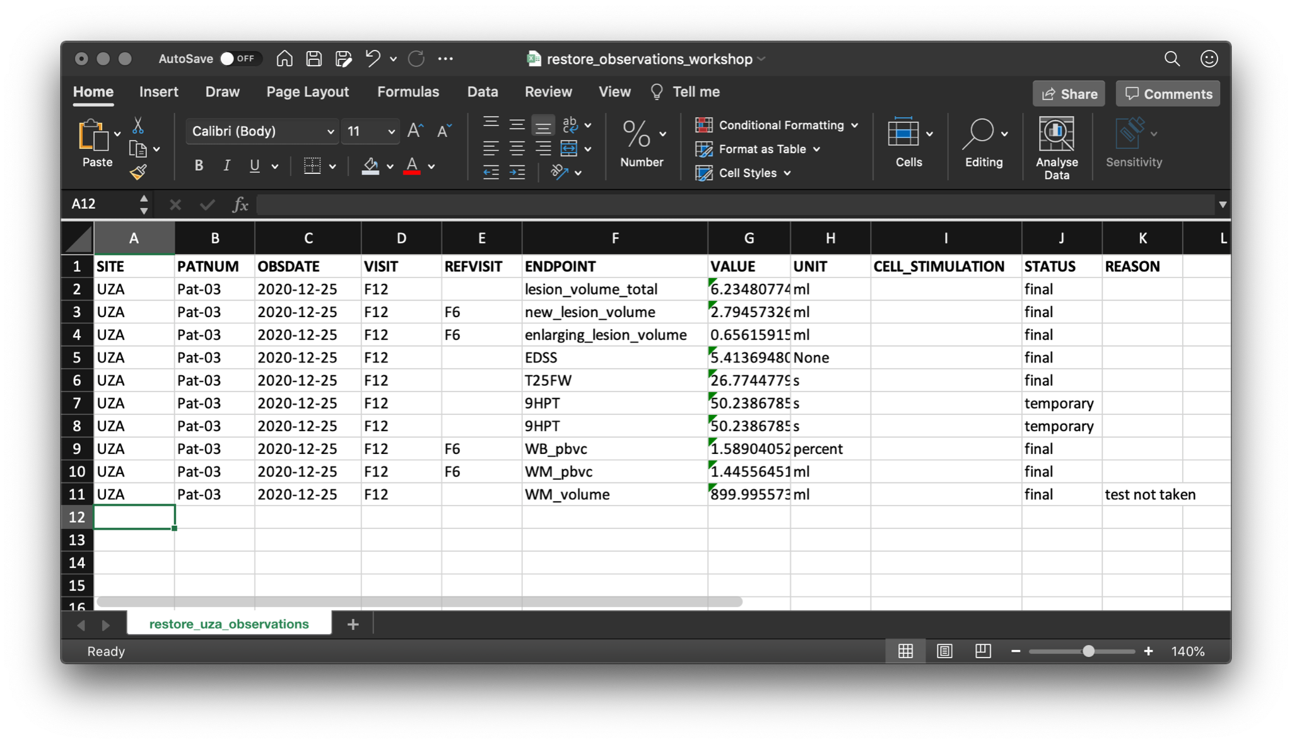
Prepare your files
  Column names should correspond
  Be aware of capitalization, formats, etc.
* Code lists (see
manual)
*
*
*
Notes:
Excel sheet name should correspond to table you want to upload
Column headers should also be identical to the column names in the database
Add the acronym of your site in the column ‘site’
Date should be in the format yyy-mm-dd
Choose from the lists of endpoints, units and status (check spelling!)
Be aware that excel can mess up values!

Slide 10
Uploading
Difference ReSToRe and Site area’s:
Each site has its own site area
You don’t have access rights to other site’s
The ReSToRe area is for browsing and downloading the full data

Slide 11
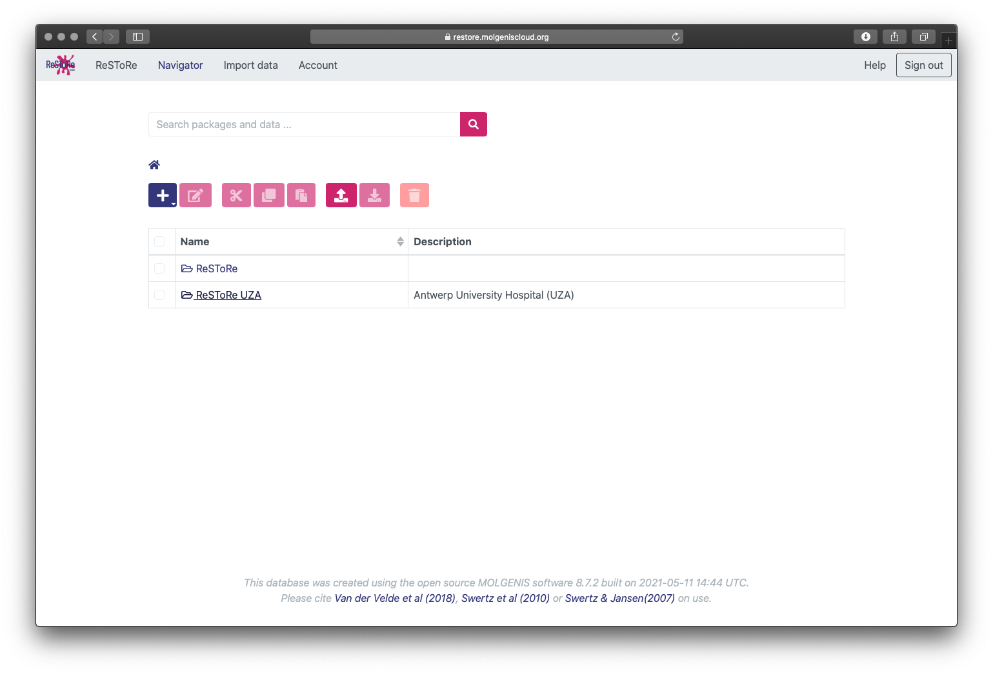
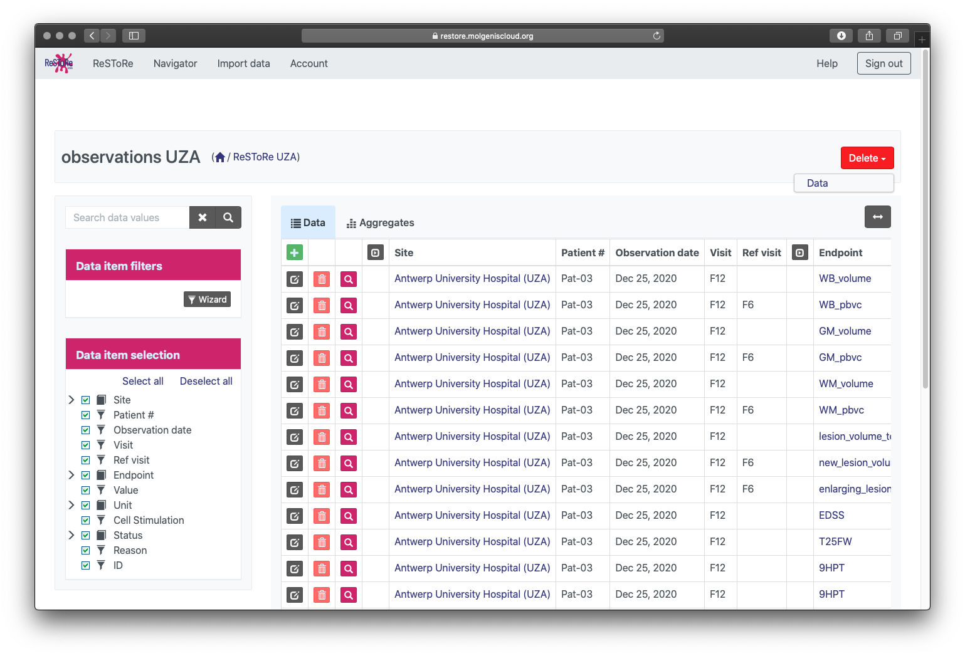
First: delete the old data
Notes:
It was decided that when there are updates to the data, all data will be uploaded again, so the old data needs to be deleted first

Slide 12
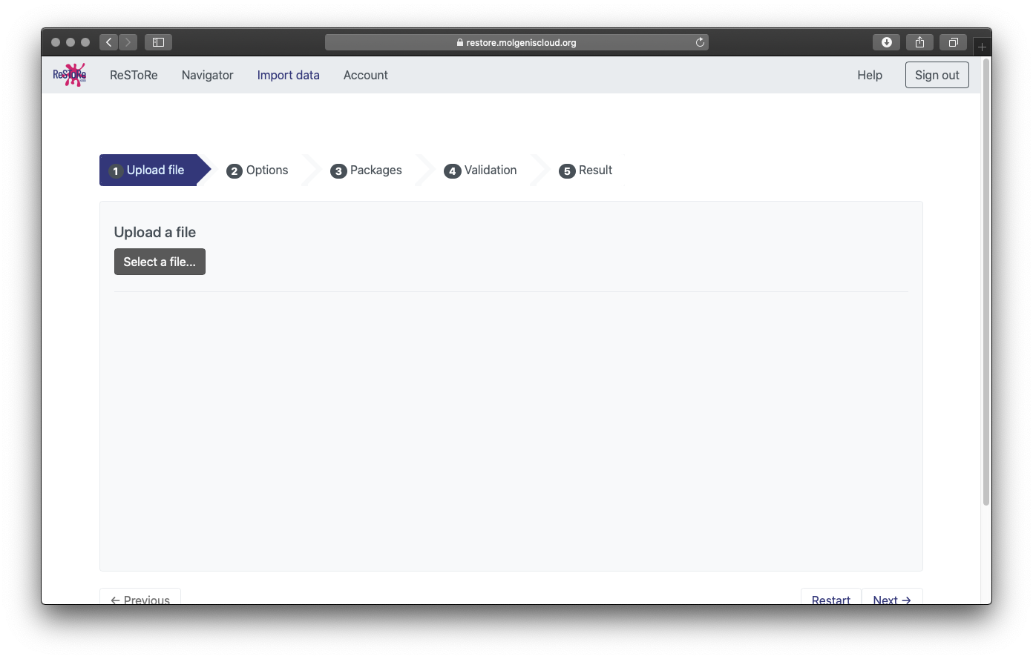
Import data
Select your file
Notes:
Excel sheet name should correspond to table you want to upload
Column headers should also be identical to the column names in the database
Add the acronym of your site in the column ‘site’
Date should be in the format yyy-mm-dd
Choose from the lists of endpoints, units and status (check spelling!)
Be aware that excel can mess up values!

Slide 13
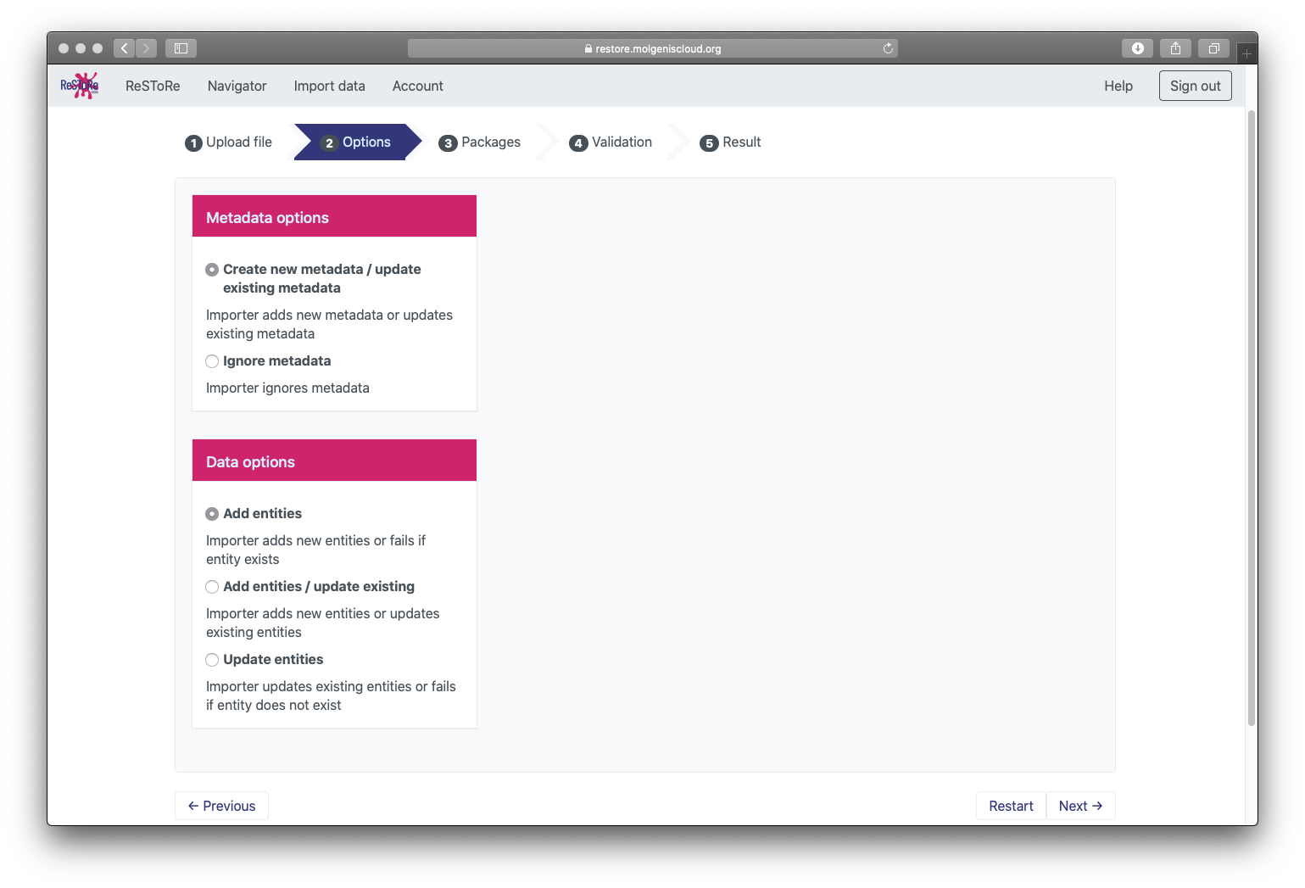
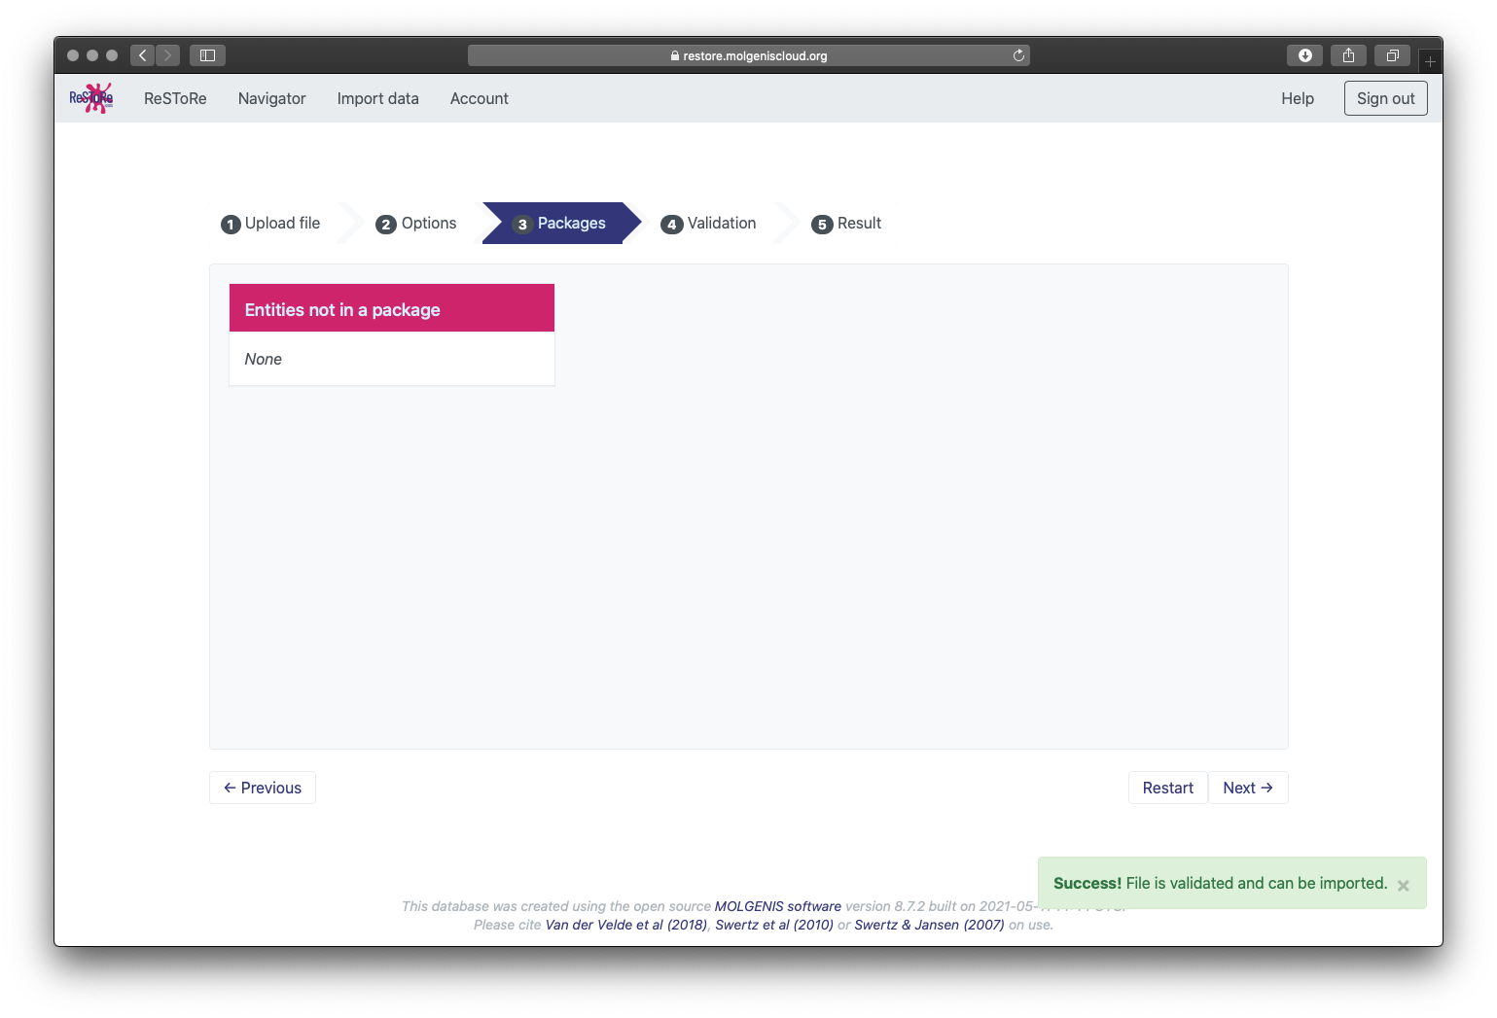
Import data
First some checks...
Notes:
Excel sheet name should correspond to table you want to upload
Column headers should also be identical to the column names in the database
Add the acronym of your site in the column ‘site’
Date should be in the format yyy-mm-dd
Choose from the lists of endpoints, units and status (check spelling!)
Be aware that excel can mess up values!

Slide 14
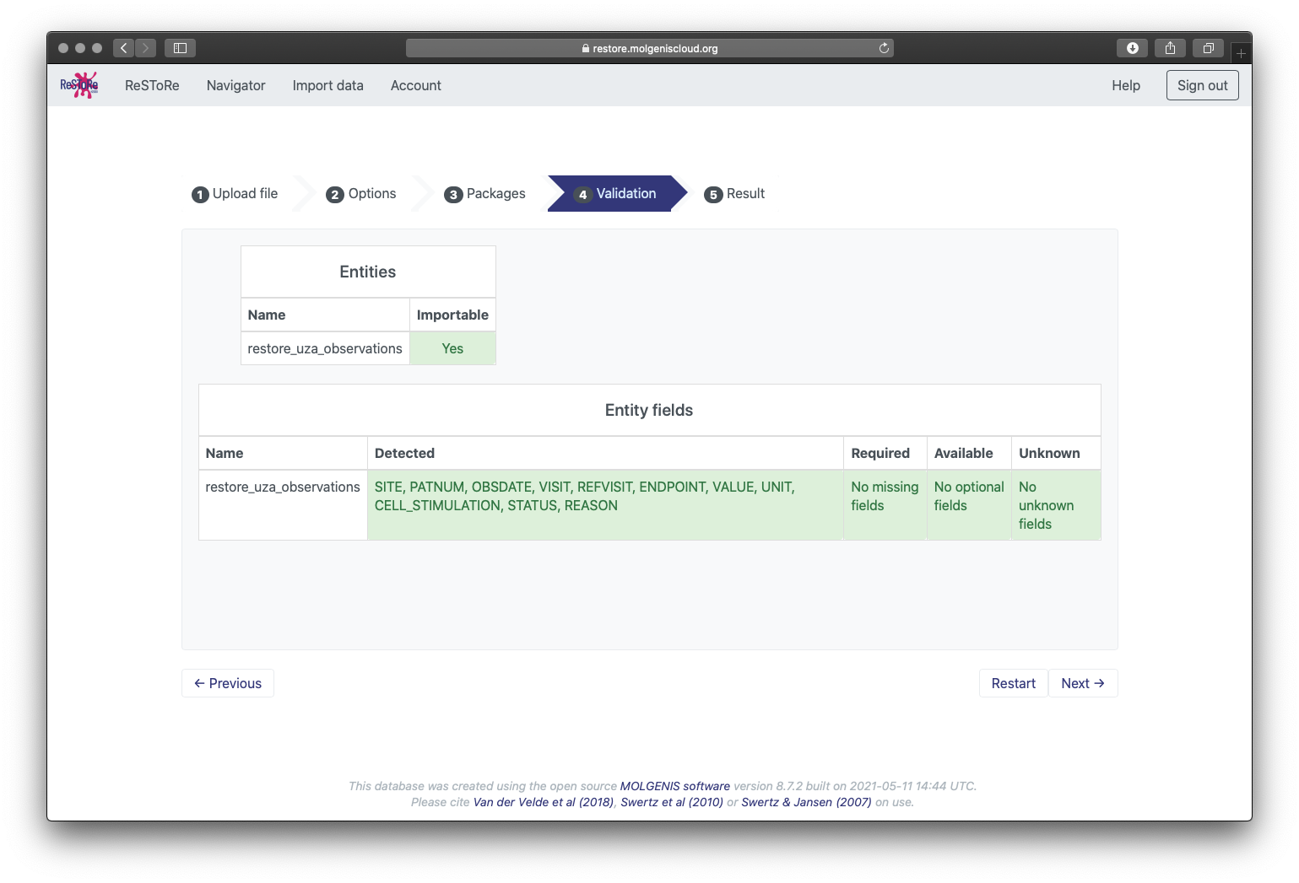
Import data
The final validation will check if all columns are correct
Notes:
Excel sheet name should correspond to table you want to upload
Column headers should also be identical to the column names in the database
Add the acronym of your site in the column ‘site’
Date should be in the format yyy-mm-dd
Choose from the lists of endpoints, units and status (check spelling!)
Be aware that excel can mess up values!

Slide 15
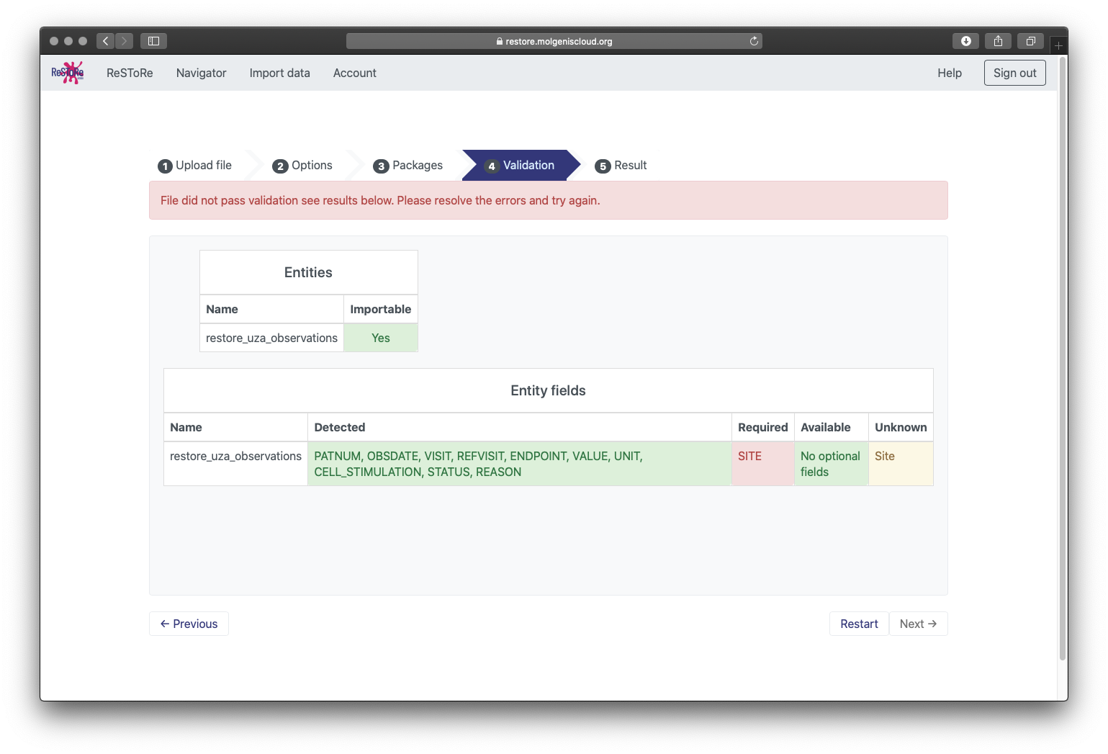
Import data
In this example the column name “SITE” was not capitalized, so the importer will show an error
Notes:
Excel sheet name should correspond to table you want to upload
Column headers should also be identical to the column names in the database
Add the acronym of your site in the column ‘site’
Date should be in the format yyy-mm-dd
Choose from the lists of endpoints, units and status (check spelling!)
Be aware that excel can mess up values!

Slide 16
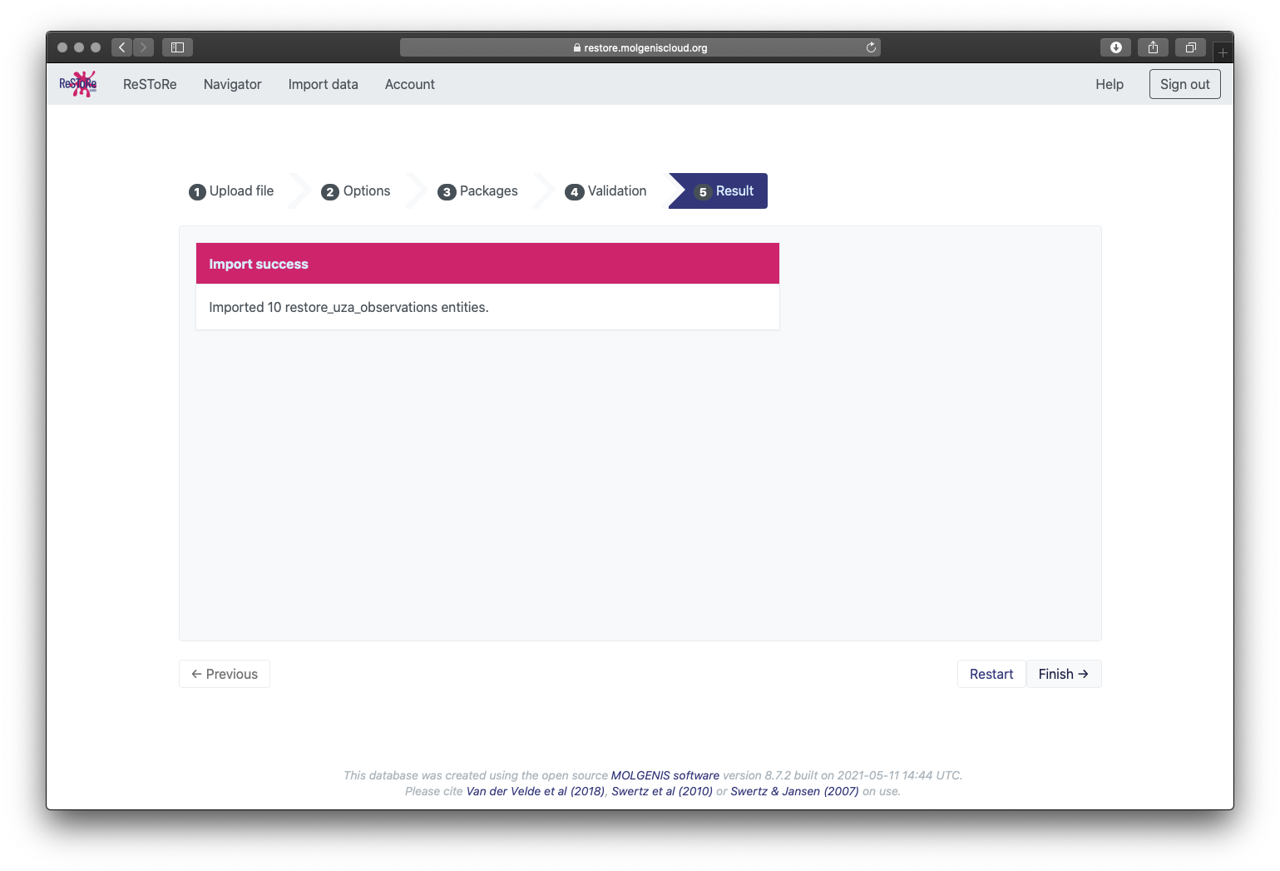
Import data
But if everything is correct… Success!
Notes:
Excel sheet name should correspond to table you want to upload
Column headers should also be identical to the column names in the database
Add the acronym of your site in the column ‘site’
Date should be in the format yyy-mm-dd
Choose from the lists of endpoints, units and status (check spelling!)
Be aware that excel can mess up values!

Slide 17
Browse (and edit) your data
Notes:
You can view your via the navigator. Here you find edit options for individual rows as well.
Note: You might see a random identifier: this one is automatically added because all rows need a unique identifier, but you can ignore this.

Slide 18
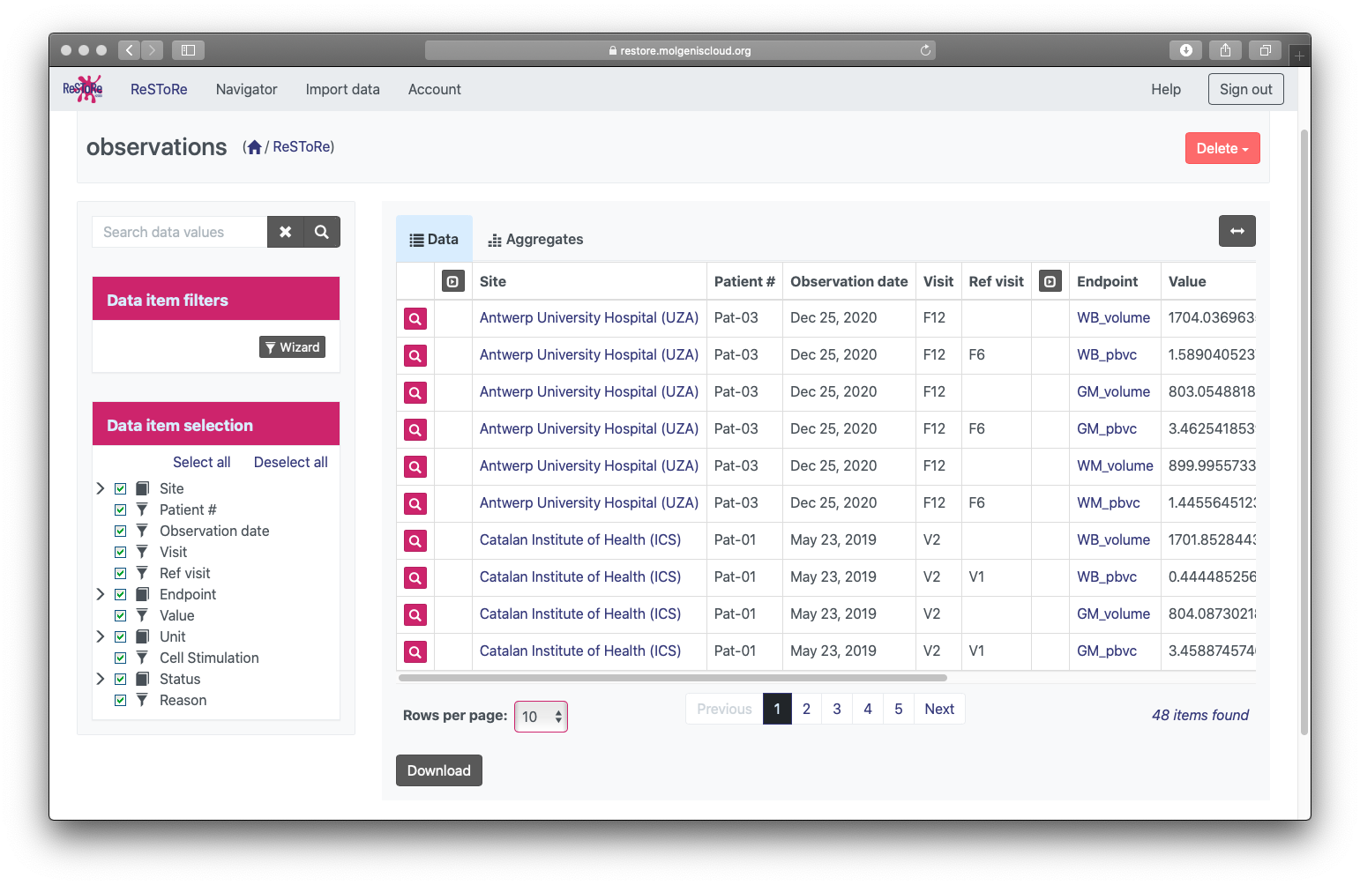
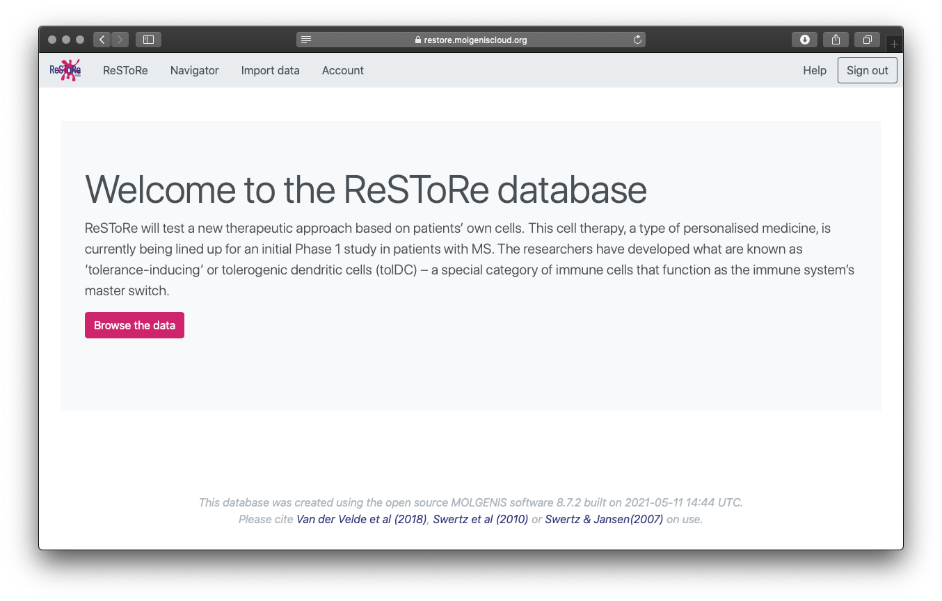
Browse all data
The data from your ‘site-area’ will be synchronized with the main table periodically
Notes:
The data from staging areas will be synchronized with the main table periodically.
Here you can browse, filter and download the data.

Slide 19
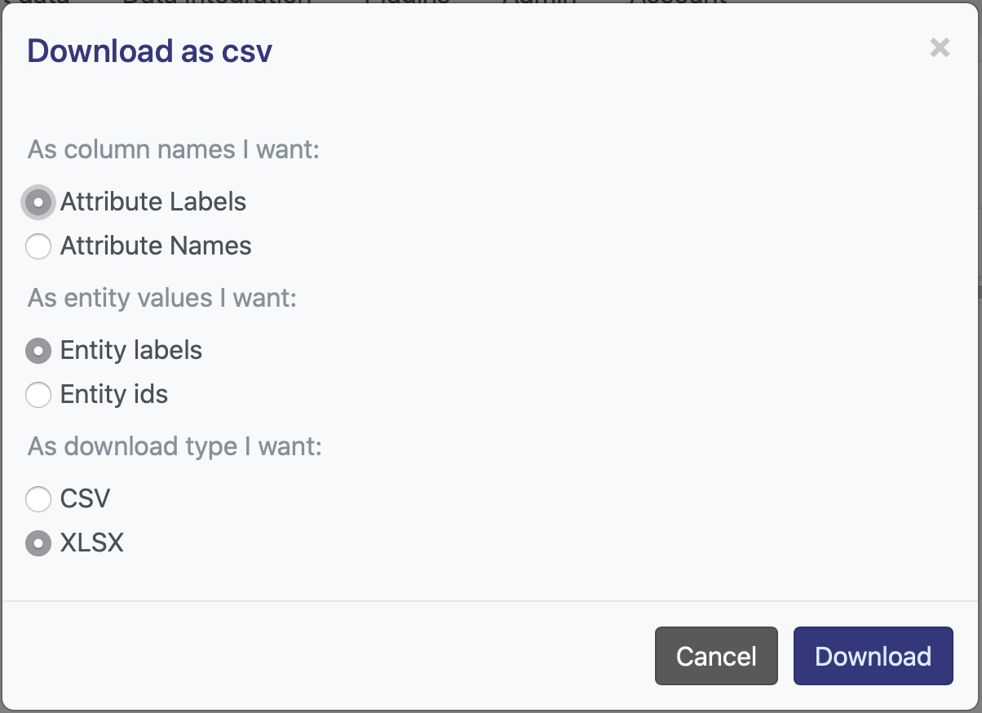
Browse all data
Here you can also download your data

Slide 20
Questions?
https://www.molgenis.org/

